Slide 1
Covid Vaccination Restful Web-Services
Team Members
Under the guidance of
Mr. Ratan Lal Gupta
Mr. Abhinav Gujral (IA)
Md Farhan Nawaz
Gaurav Singh
Moh Shahrukh Khan
Micheal George
Avinash Kumar
Shivam Maheshwari

Slide 2
Table Of Content
Project information
Technologies Used
What We Are Building
Pre-Requisites
Understanding ER-Diagram
Setup
Services

Slide 3
COVID-19 Vaccination Backend Application This application aims to deliver a system to manage the vaccination process. The application aims to provide a user-friendly

Slide 4







Technology That We Used

Slide 5



What Are We Building Today?
MySql
Store User-Vaccination data to database.
Use Swagger to visualize the data from the backend.

Slide 6
Pre-Requisites
MySQL
JSON
Swagger UI
GitHub For Code Collaboration
Required Dependencies Installed and Virtual Environment Activated

Slide 7


Understanding ER Diagram & Relevant Components

Slide 8
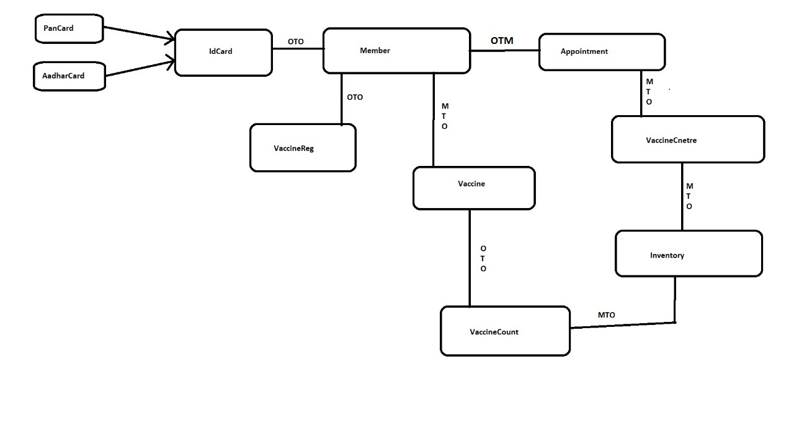
Understanding ER Diagram and Relevant Components

Slide 9
Set up Relational Database & Mapping
#ORM s/w specific properties
spring.jpa.hibernate.ddl-auto=update
spring.jpa.show-sql=true

Slide 10
Services That We Are Providing
User Signup and Login
See different lists of vaccines and vaccination centres available
Enter your details, choose your desired time slot and register for vaccination
Generate Appointment
Get Vaccination Details (Date and time of vaccination as per dose)
User Logout
Admin Features

Slide 11
A user is signed into the portal and has a unique ID like (SSN), name, location and a phone number.
Each county or a district has different vaccination centers each of which has a unique ID, which records the track of people vaccinated, the dose of the vaccine and the stock of vaccination left.
A person can get the vaccine from any center but has to get the same 2 doses of vaccine. Each vaccine has a unique number which can be used to track the person who has received the vaccine and the date they got the vaccine.
There is also information about the type of vaccine and the possible side effects caused by the vaccine in each dose.

Slide 12
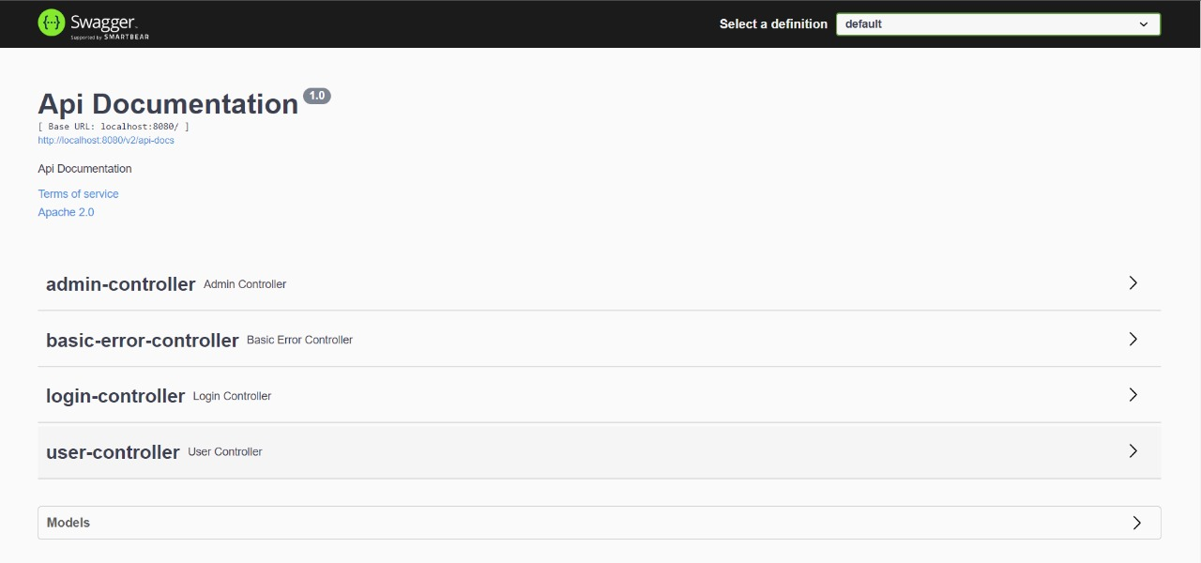
Launch Rest API Backend on Covid-19 Application Service

Slide 13
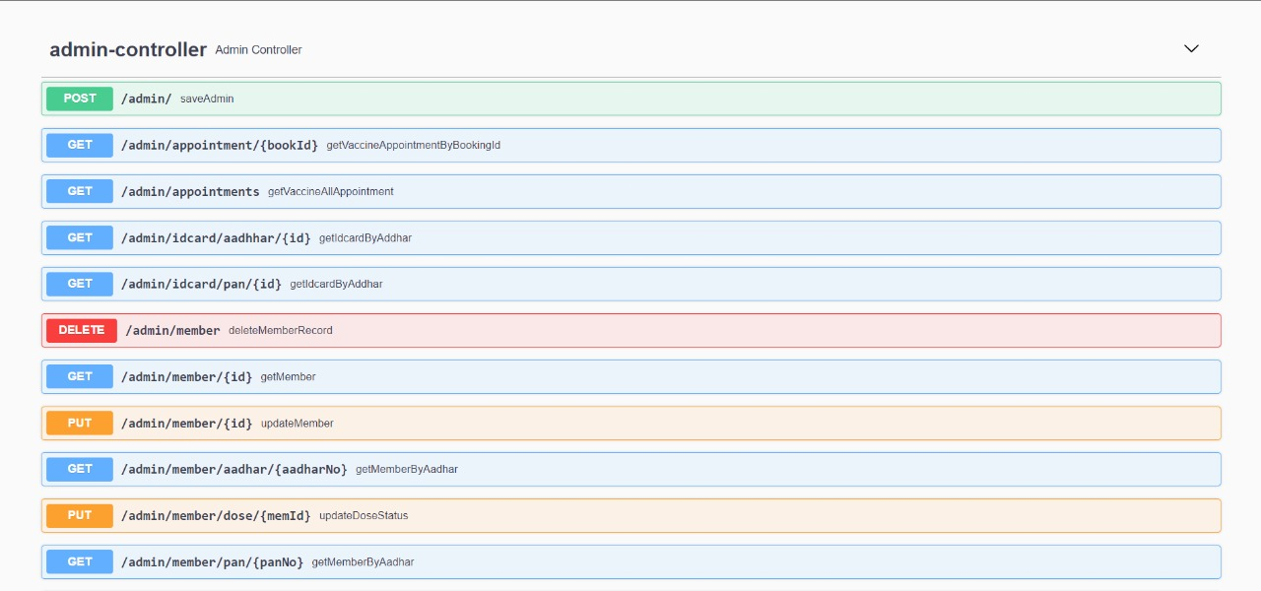
What Did We Build?
.

Slide 14
Resources:
Code on GitHub:
https://github.com/nvFARHAN/cowin.gov.in/
README Instructions:
https://github.com/nvFARHAN/cowin.gov.in/edit/master/README.md

Slide 15

Thank you!

